Slide 1
Express Yourself Clearly
Day 42
April 26, 2016

Slide 2
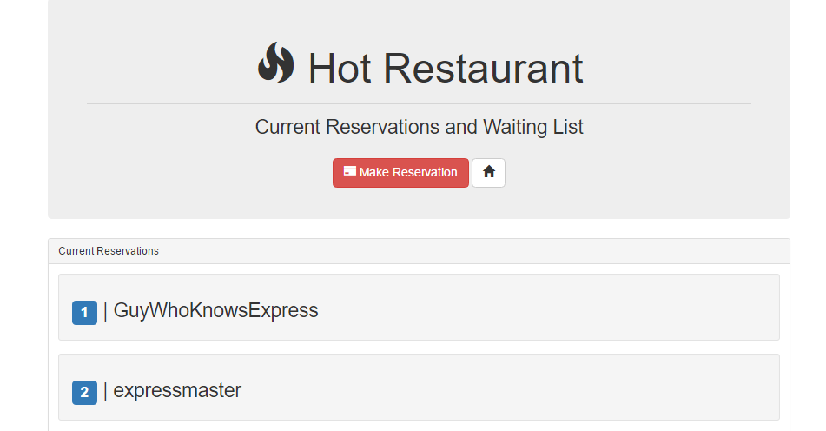
Recap Activity
Today! A Deep Re-Examination of Reservations.

Slide 3
Concerns

Slide 4
Comment #1 - Concern
“This is all so confusing…”

Slide 5
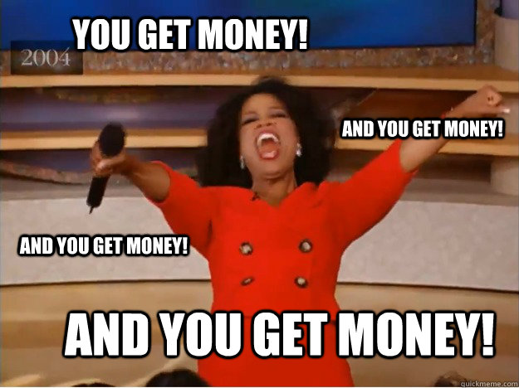
Comment #1 - Response
And it will be for your employer as well.

Slide 6
Comment #2 - Concern
“I feel like I’m just copying and pasting”

Slide 7
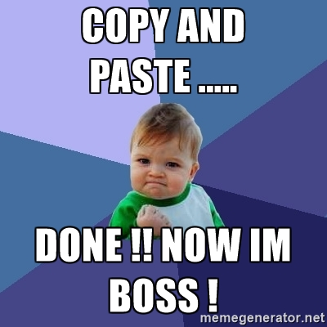
Comment #2 - Response
Backend code libraries mean YOU have to code less.
Often you are just copying “best-practices” over and over again.

Slide 8
Today’s Class

Slide 9
Today’s Objectives
We will recap the concepts behind server-side code.
We will recap the concepts behind Express Routing
We will dissect the Hot-Restaurant Activity
We will dissect the Star Wars Activity
We will talk about Node deployment via Heroku
We will work on an extra activity (time-permitting)

Slide 10
Your Objectives
Before you walk out the door you should…
Know how to create a generic Express Server (copy and paste is fine).
Know how to create a basic Express GET route
Know how to create an Express POST route
Know what POST Man is for
Understand “conceptually” how to use AJAX to GET and POST data to an Express server

Slide 11

Focus!
Node + Express Servers and Routing are two of the
MOST IMPORTANT CONCEPTS
in the ENTIRE program.
Seriously… Try to learn this now.

Slide 12
FOCUS!
Relax. That doesn’t mean its hard.

Slide 13
Question List

Slide 14
A Moment to Refresh

Slide 15
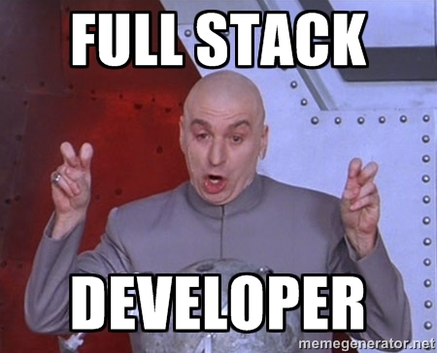
Full-Stack Development?

Slide 16
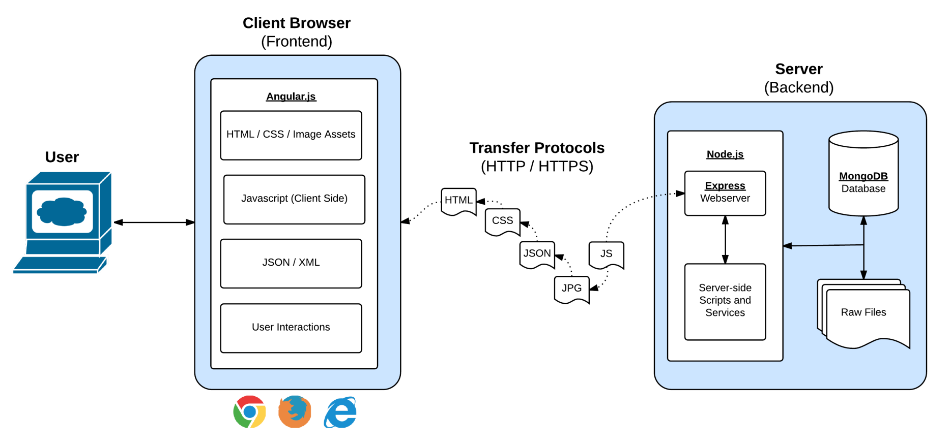
Full-Stack Development
In modern web applications there is a constant back-and-forth communication between the visuals displayed on the user’s browser (frontend) and the data and logic stored on the server (backend).

Slide 17
Remind me again…
What is a server?
In modern web applications there is a constant back-and-forth communication between the visuals displayed on the user’s browser (frontend) and the data and logic stored on the server (backend).
Notes:
A machine or program that takes a request from client that handles requests and responds to them.

Slide 18
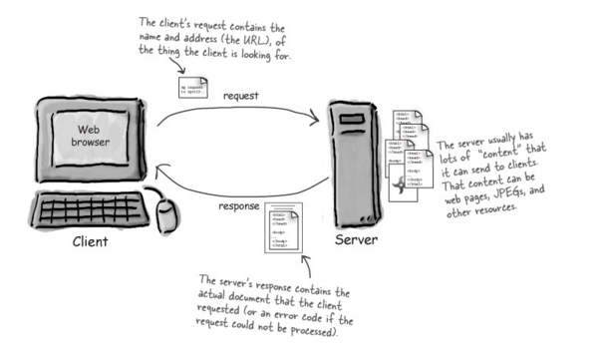
Server Definition
Server: Code that handles requests and respond to them.
Notes:
Who/what is making requests? The client. Client makes requests via the browser.

Slide 19
Remind me again…
What are examples of server-side functions?
In modern web applications there is a constant back-and-forth communication between the visuals displayed on the user’s browser (frontend) and the data and logic stored on the server (backend).

Slide 20
Server-Side Code in Action!
API that parse URL parameters to provide selective JSONs
Firebase methods that provide a timestamp back to users
Clicking an invoice that provides a PDF report
Image processing software that takes an image applies a filter, then saves the new version
Google providing “results” relevant to your searches on other sites.

Slide 21
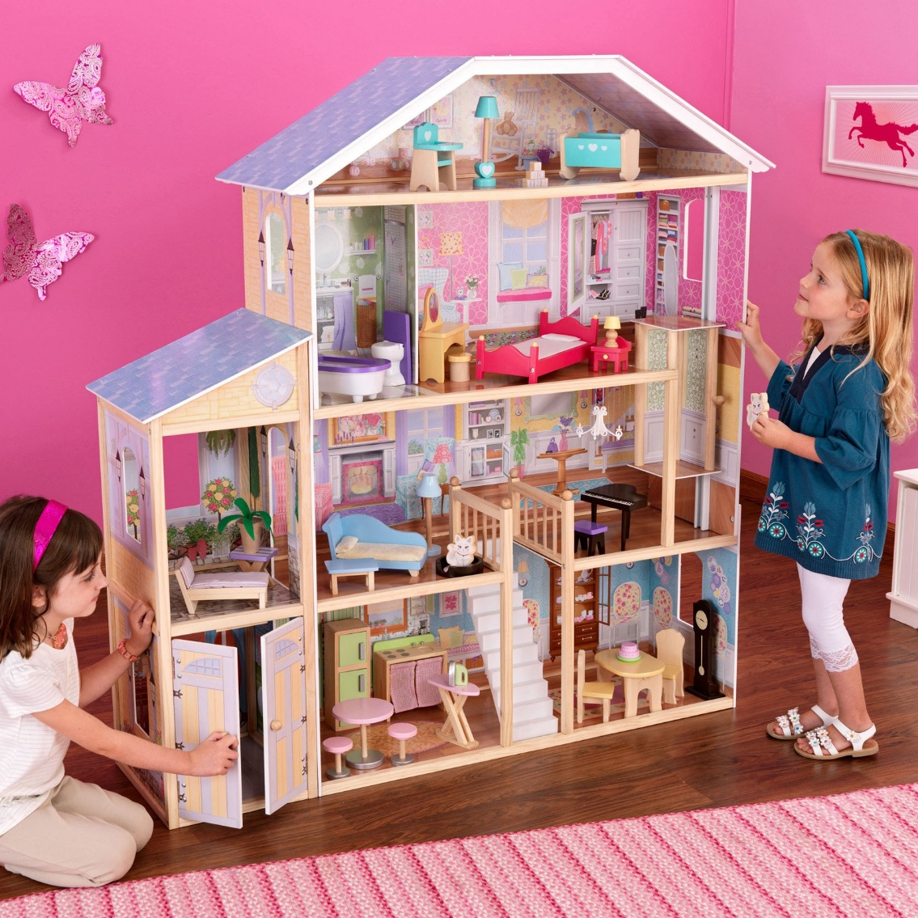
Remind me again…
Where does the server live?
In modern web applications there is a constant back-and-forth communication between the visuals displayed on the user’s browser (frontend) and the data and logic stored on the server (backend).

Slide 22

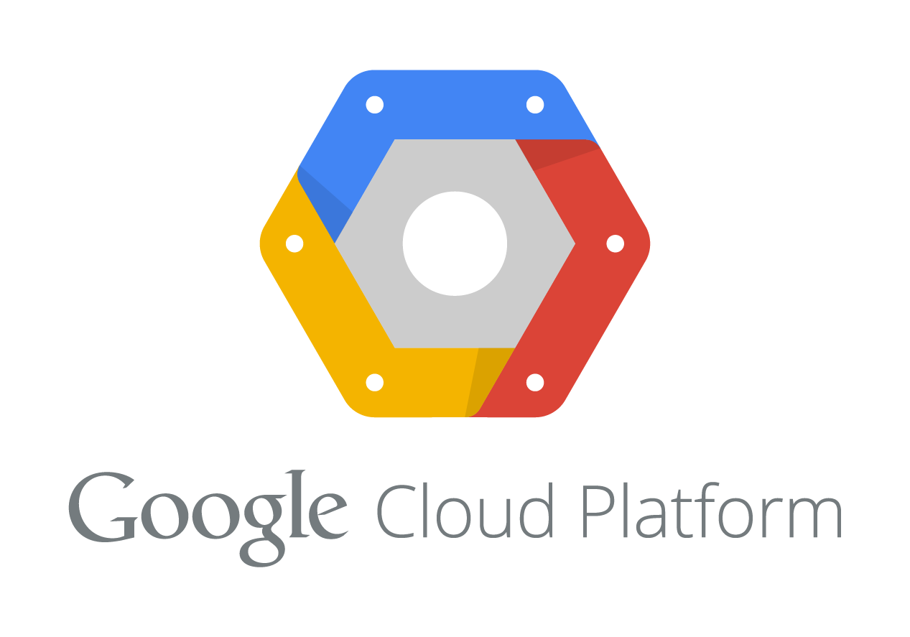

Servers Live
Servers live in dedicated hardware intended to handle ALL the requests and responses of many clients.
Servers can live most often live on cloud platforms like AWS, Heroku, Google Cloud, etc.
Notes:
Look at hot-restaurant app we made on Saturday. Inspect it and you see the front-end code, the tables, etc. but don’t see the app.get, app.post. That code is on the heroku level. Once you deploy you’re hiding away all the info for requests. It hides there.

Slide 23
Express Recap

Slide 24
Remind me again…
What is Express?
In modern web applications there is a constant back-and-forth communication between the visuals displayed on the user’s browser (frontend) and the data and logic stored on the server (backend).
Notes:
Express is a node framework for building servers. Framework is a scaffold that makes building tasks easier.

Slide 25
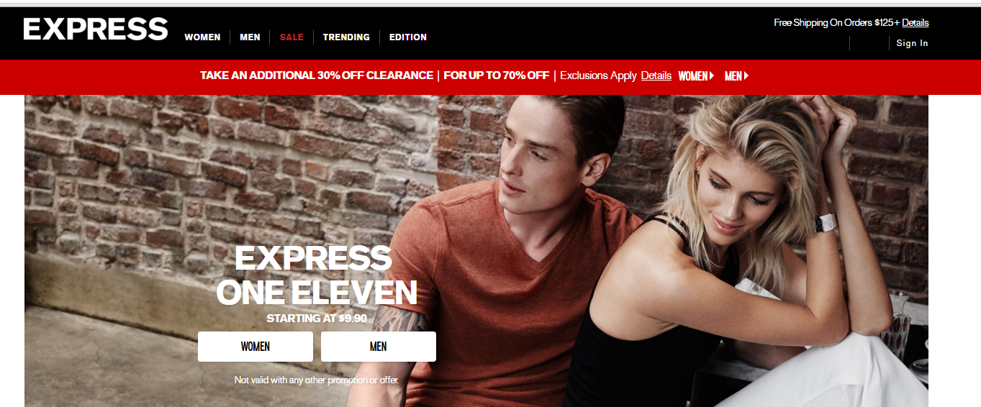
Express.JS
No. Express.JS is much more useful.
In modern web applications there is a constant back-and-forth communication between the visuals displayed on the user’s browser (frontend) and the data and logic stored on the server (backend).

Slide 26
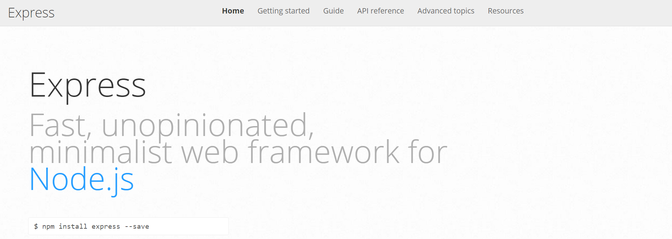
Express.JS
Web framework for node to make creating code for server much simpler
In modern web applications there is a constant back-and-forth communication between the visuals displayed on the user’s browser (frontend) and the data and logic stored on the server (backend).

Slide 27
Remind me again…
What is a route?
In modern web applications there is a constant back-and-forth communication between the visuals displayed on the user’s browser (frontend) and the data and logic stored on the server (backend).

Slide 28
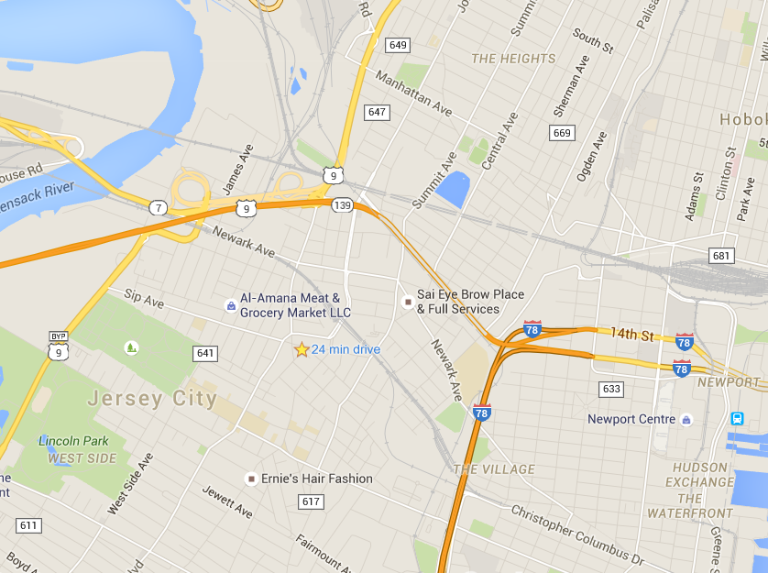
Routes = Maps
In modern web applications there is a constant back-and-forth communication between the visuals displayed on the user’s browser (frontend) and the data and logic stored on the server (backend).

Slide 29
Routes = Maps
/join
User is shown the “Join” Page
/add
User is shown the “Add” Page
User visits a link…
/search/:name
User is shown the “search” page with just the results relevant to the name.

Slide 30
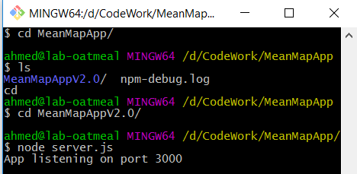
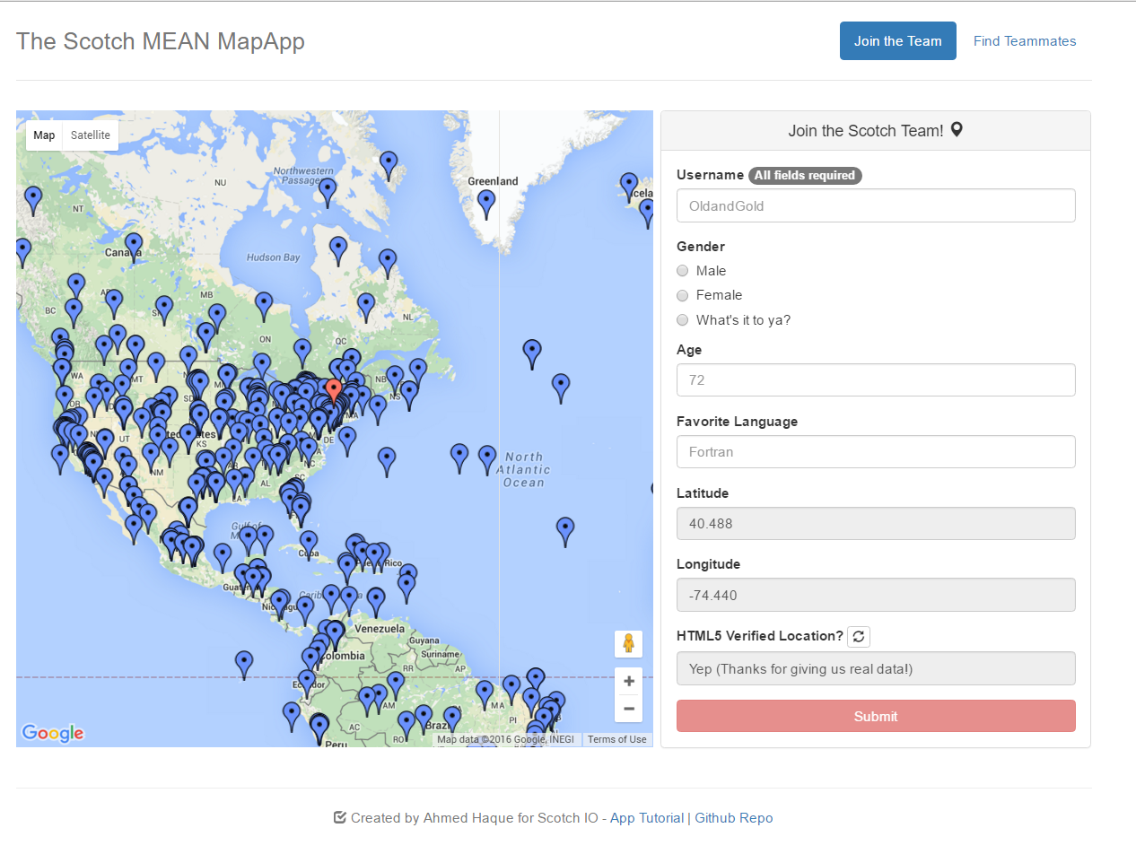
Client-Server Communication (GET)
Client Browser
Node Server
1) User visits /join
(GET Request)

Slide 31
Client-Server Communication (GET)
Client Browser
Node Server
1) User visits /join
(GET Request)
3) Server responds by providing HTML with web form data
2) Request triggers the code in the Server route. The server then finds the relevant HTML content and data

Slide 32
Client-Server Communication (POST)
Client Browser
Node Server
1) User submits form entry
(POST Request)

Slide 33
Client-Server Communication (POST)
Client Browser
Node Server
1) User submits form entry
(POST Request)
3) Server responds by providing HTML with web form data
2) Request triggers the code in the Server route. The server then adds the user to the map and database.

Slide 34
jQuery Recap

Slide 35
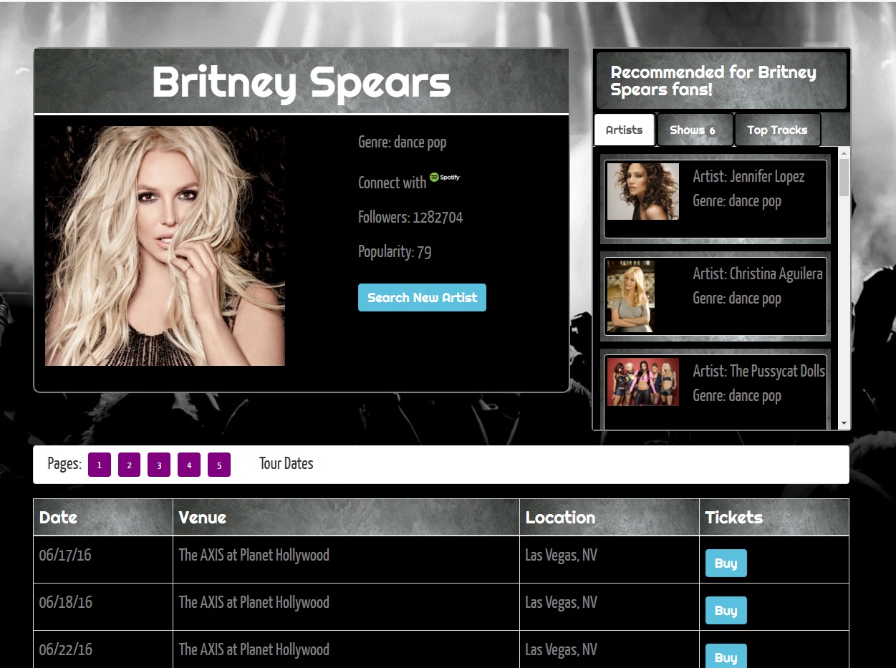
Muskick

Slide 36
Activity Recap

Slide 37
Homework!

